Slide 1
CS419 Recitation Class
Topic：Cryptography
Notes:
/krɪpˈtɑːɡrəfi/

Slide 2
Review: The Vigenère Cipher
How to defeating frequency analysis ?
How to attack Vigenère Cipher ?
Find the length of the key.
Kasiski test
Divide the message into that many shift cipher encryptions.
Use frequency analysis to solve the resulting shift ciphers.
One thread: Use different keys in different locations
• Example: one-time pad, stream ciphers
Another way: Make the unit of transformation larger, rather than encrypting letter by letter, encrypting block by block
• Example: block cipher
Notes:
Vidgenni e

Slide 3
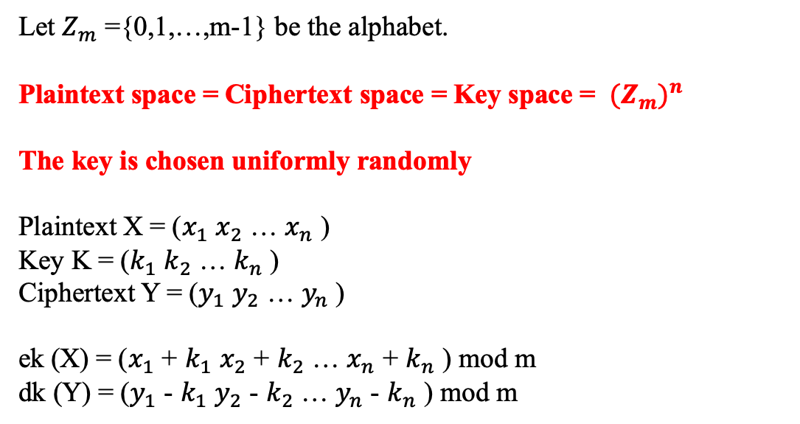
ONE-TIME PAD
Let $Z_{m}$ ={0,1,…,m-1} be the alphabet.
Plaintext space = Ciphertext space = Key space = ${{(Z}_{m})}^{n}$
The key is chosen uniformly randomly
Plaintext X = ($x_{1}$ $x_{2}$ … $x_{n}$ )
Key K = ($k_{1}$ $k_{2}$ … $k_{n}$ )
Ciphertext Y = ($y_{1}$ $y_{2}$ … $y_{n}$ )
ek (X) = ($x_{1}$ + $k_{1}$ $x_{2}$ + $k_{2}$ … $x_{n}$ + $k_{n}$ ) mod m
dk (Y) = ($y_{1}$ - $k_{1}$ $y_{2}$ - $k_{2}$ … $y_{n}$ - $k_{n}$ ) mod m
PERFECT SECRECY ?
Notes:
Vidgenni e

Slide 4
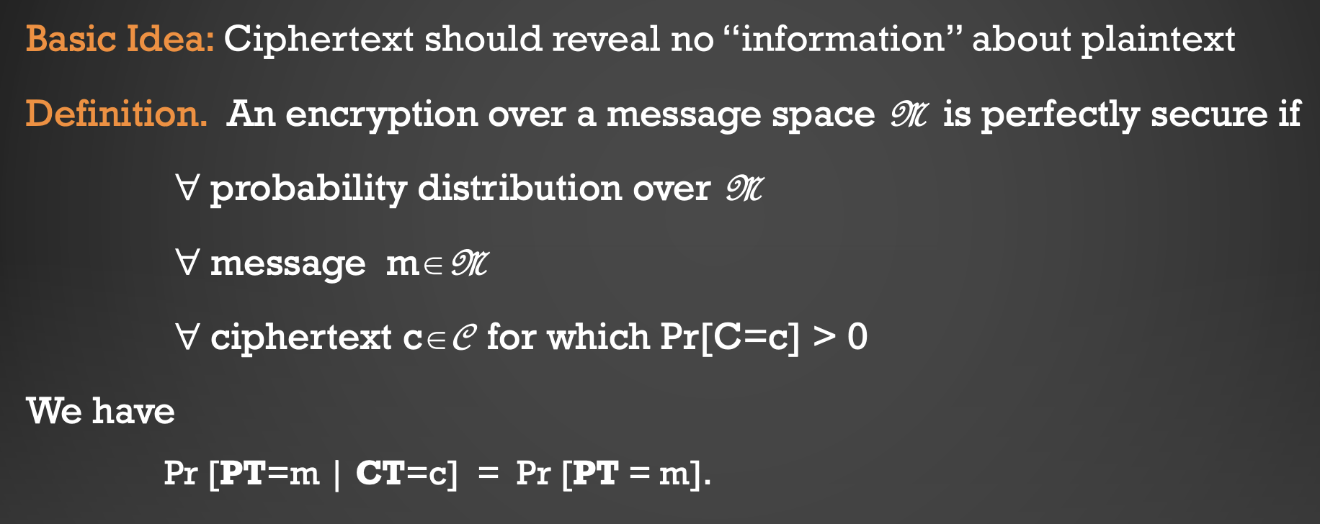
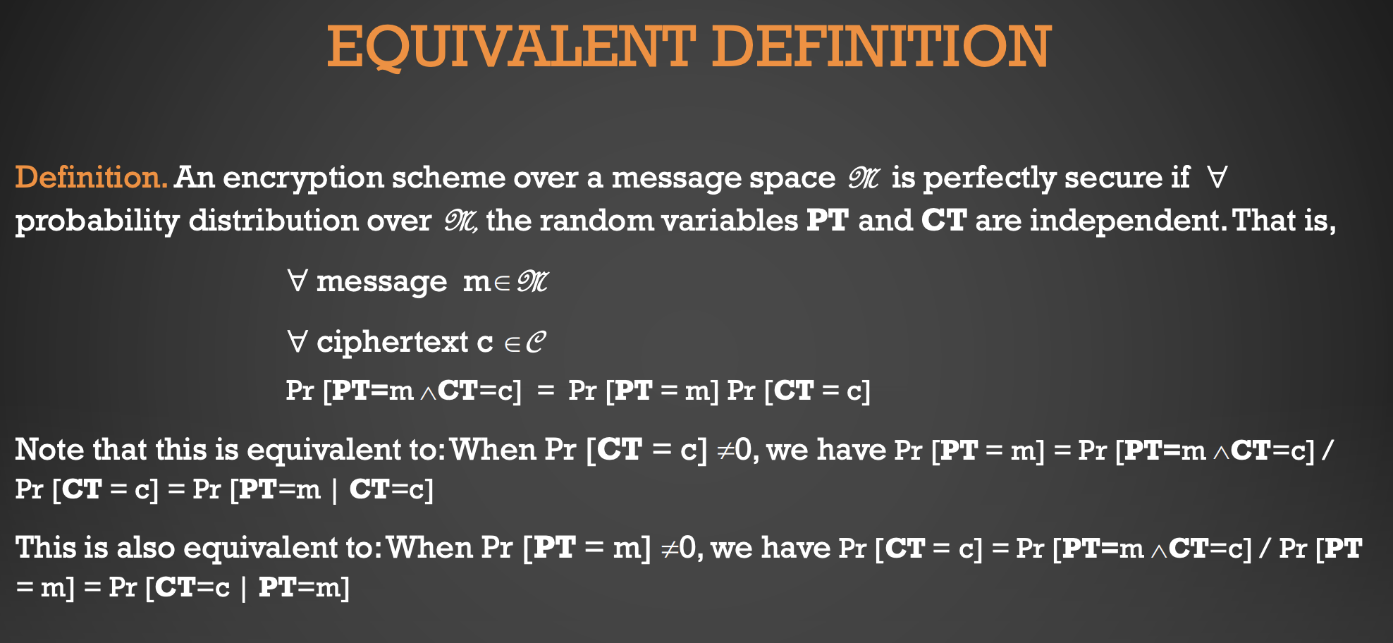
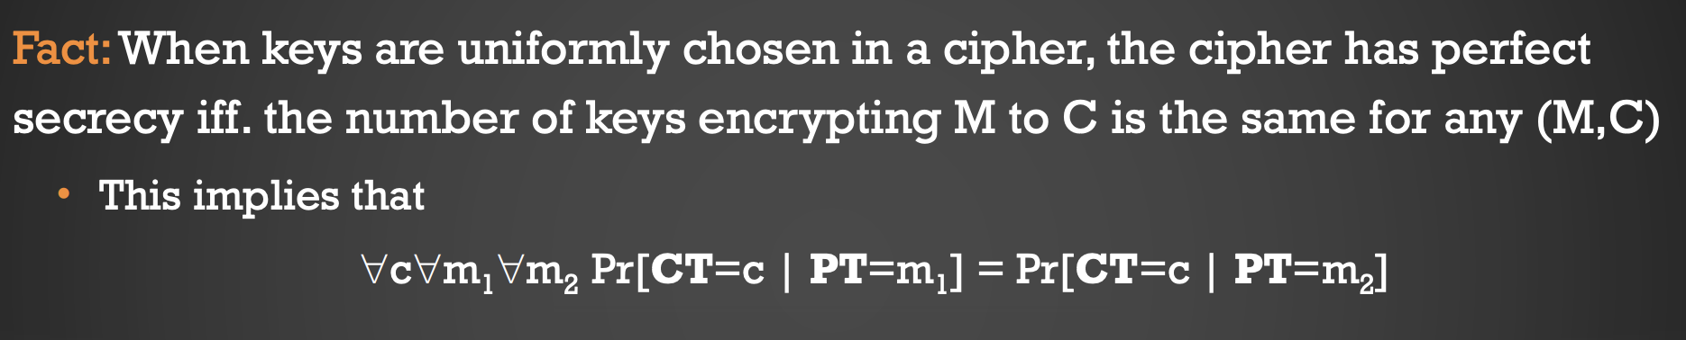
PERFECT SECRECY
Notes:
Vidgenni e

Slide 5
ONE-TIME PAD and PERFECT SECRECY
1. One-Time Pad uses a very long key. If the key is not chosen randomly, this is not One-Time Pad anymore and this does not have perfect secrecy
2. The key in One-Time Pad should never be reused.
3. To use one-time pad, one must have keys as long as the messages.
This is difficult to do in practice.
Notes:
Vidgenni e

Slide 6
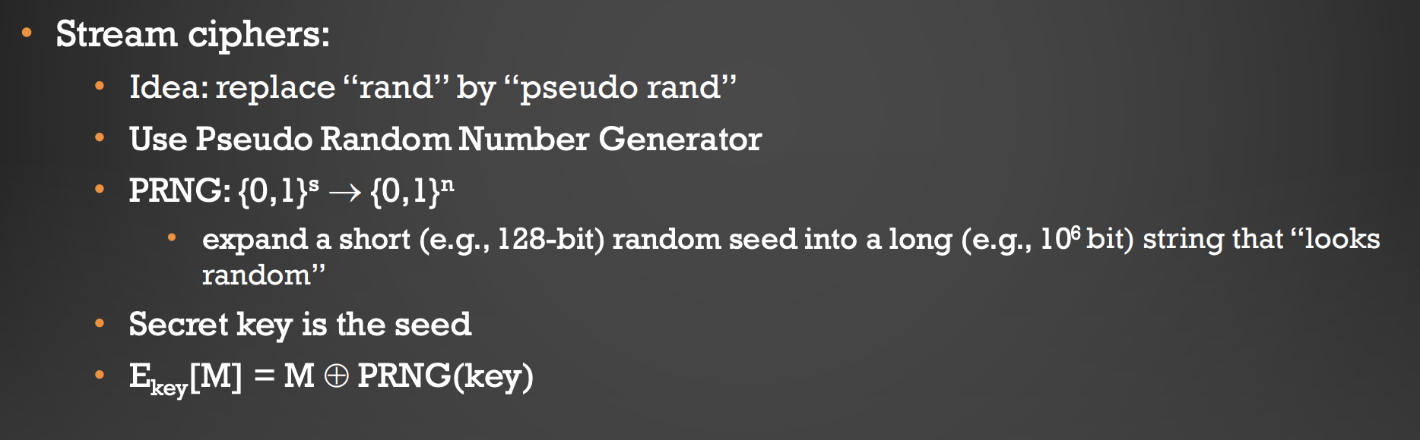
STREAM CIPHERS
The same seed always gives the same output stream
Simulation requires uniform distributed sequences
Example : THE RC4 STREAM CIPHER
Typical stream ciphers are very fast
Widely used, often incorrectly
Security depends on PRNG
stream ciphers don’t have perfect secrecy
Notes:
Vidgenni e

Slide 7
COMPUTATIONAL SECURITY
Perfect secrecy is too difficult to achieve.
• The computational approach uses two relaxations:
• Security is preserved only against efficient (computationally bounded) adversaries
• Adversary can only run in feasible amount of time
• Adversaries can potentially succeed with some very small probability (that we can ignore the case that actually happens)
Notes:
Vidgenni e

Slide 8
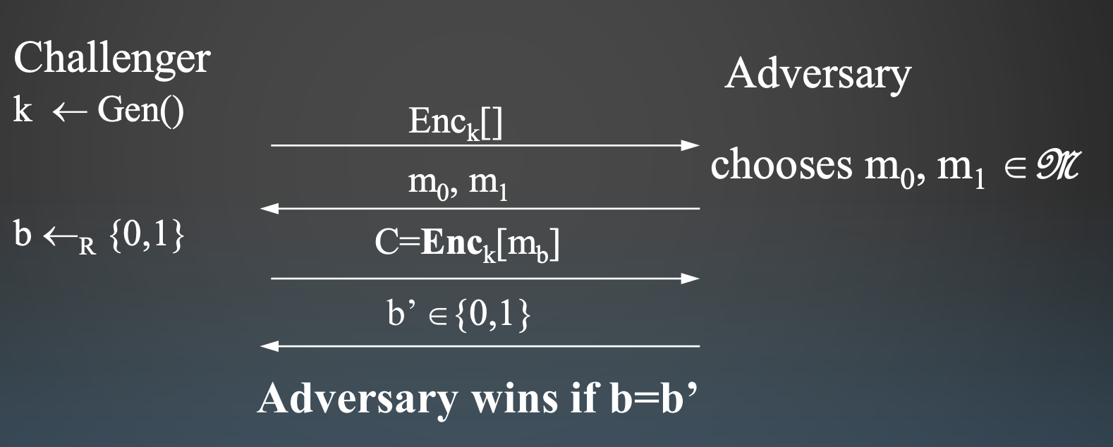
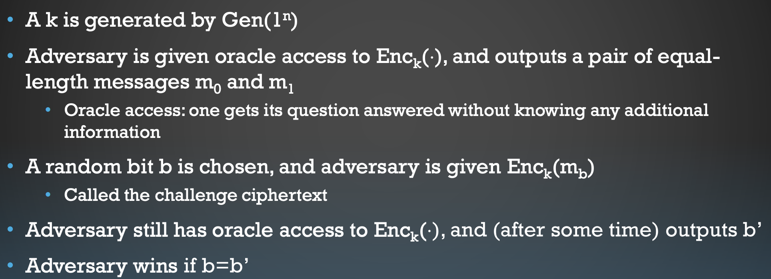
IND-CPA SECURITY:
• Perfect secrecy means: any plaintext is encrypted to a given ciphertext with the same probability, i.e., given any pair of M0 and M1 , the probabilities that they are encrypted into a ciphertext C are the same (Hence no adversary can tell whether C is ciphertext of M0 or M1).
• IND-CPA means: With bounded computational resources, the adversary cannot tell which of M0 and M1 is encrypted in C
• Stream ciphers can be used to achieve IND-CPA security when the underlying PRNG is cryptographically strong • (i.e., generating sequences that cannot be distinguished from random, even when related seeds are used)
• If only having computational security, then can be broken by a brute force attack

Slide 9
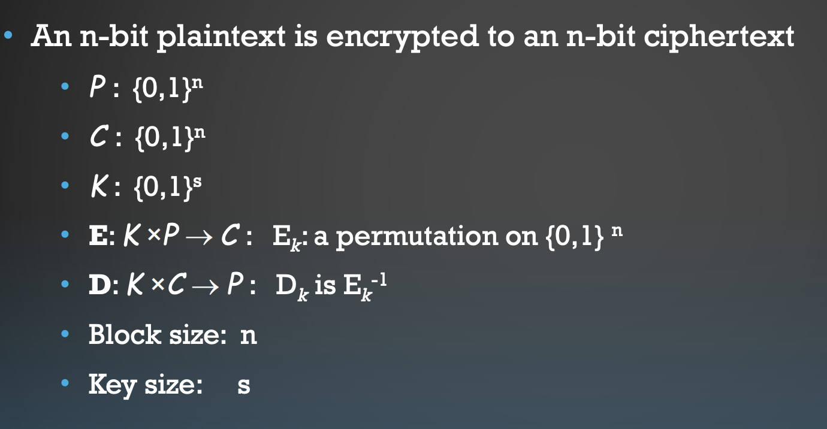
Block Ciphers
Another way to defeat frequency analysis:
• Make the unit of transformation larger, rather than encrypting letter by letter, encrypting block by block
Notes:
Vidgenni e

Slide 10
Two standards of Block Ciphers
DATA ENCRYPTION STANDARD (DES)
ADVANCED ENCRYPTION STANDARD (AES)
• Block size is 64 bits; Key size is 56 bits
• Has 16 rounds
• main vulnerability is short key size.
• Standard attacks
• exhaustive key search
• dictionary attack
• differential cryptanalysis, linear cryptanalysis
• Block size: 128 bits
• Variable key size: 128, 192, or 256 bits.
• No known weaknesses
Notes:
Vidgenni e

Slide 11
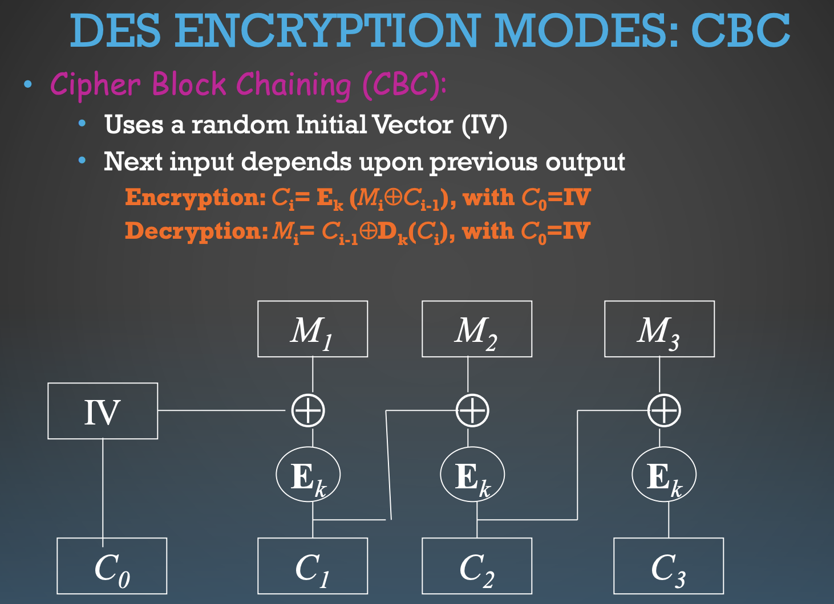
Encryption modes of Block Ciphers
• Randomized encryption: repeated text gets mapped to different encrypted data.
• Each ciphertext block depends on all preceding plaintext blocks.
Notes:
Vidgenni e

Slide 12
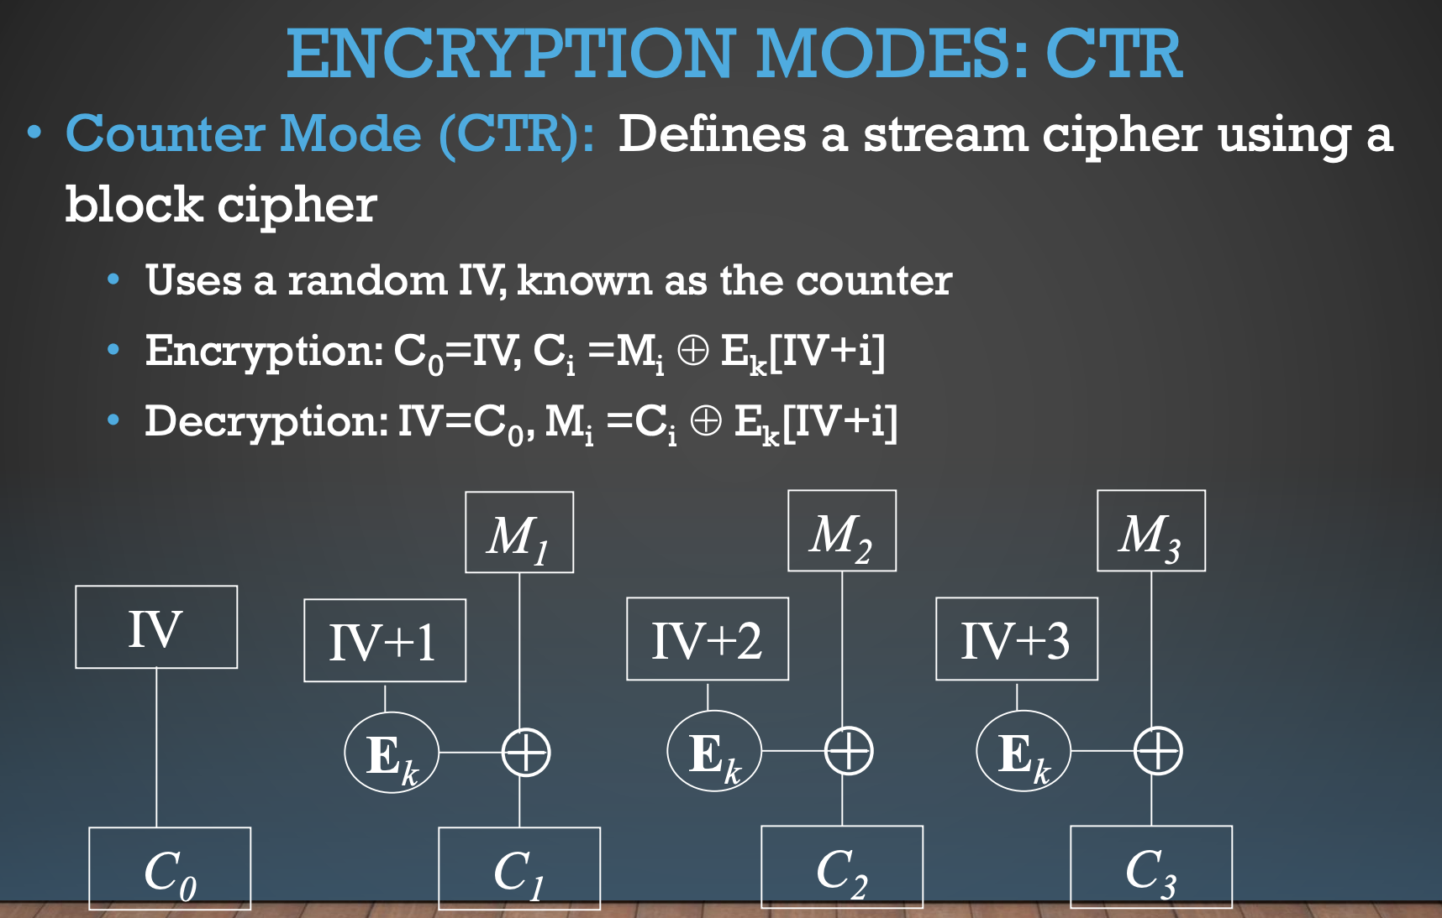
Encryption modes of Block Ciphers
• Randomized encryption: when starting counter is chosen randomly
• Random Access: encryption and decryption of a block can be done in random order, very useful for hard-disk encryption.
Notes:
Vidgenni e

